Slide 1
Virtual Research Day: Frontiers in Computational Science and Engineering Research and Software
initiative for Computational Science and Engineering (iCSE)
Columbia University
MEETING AGENDA
1:00-1:10PM | Shih-Fu Cheng, Senior Executive Vice Dean | Introductory remarks
1:10-1:30PM | Jacob Fish, CEEM | iCSE structure and affiliates program; current research overview
1:30-1:45PM | Qiang Du, APAM | Algorithms for informative and intelligent scientific computing
1:45-2:00PM | Zoran Kostic, EE | Challenges in meeting latency targets of a computationally demanding smart city application
2:00-2:15PM | Alan West, CHEM | Simulation of Performance and Degradation of Battery Electrodes
2:15-2:30PM | Ali Hirsa, IEOR | AI Applications in Finance
2:30-2:45PM | Gerard Ateshian, ME | FEBio: An Open-Source Multiphysics Finite Element Software for Biomechanics and Biophysics
2:45-3:00PM | Vijay Vedula, ME | Cyberinfrastructure for patient-specific modeling of cardiovascular disease
3:00-3:15PM | Haim Waisman, CEEM | Topology Optimization of Structures for Brittle/Ductile Fracture Resistance
3:15-3:30PM | Sanat Kumar, CHEM | The power of machine learning in materials discovery
3:30-3:45PM | Kyle Mandli, APAM | Computational Approaches to Coastal Flooding with Climate Change Impacts
3:45-4:00PM | WaiChing Sun, CEEM | Microstructural-informed plasticity with reinforcement learning guided data exploration
4:00-4:15PM | Simon Billinge, APAM | Towards the autonomation of experiments: quasi-real time analysis of heterogeneous streaming data from scientific experiments
4:15-4:30PM | Marco Giometto, CEEM | Hybrid Physics-Data Driven Wall-Layer Models for Turbulence
4:30-4:45PM | Renata Wentzcovitch, APAM | QUANTUM ESPRESSO: a modular and open-source software project for quantum simulations of materials (tentative)
4:45-5:00PM | Q&A
Notes:
Hello to everybody. My name… I see a lot of familiar names and faces. Thank you all for attending the virtual research day of our new initiative in CSE. As you can see, we have a very packed agenda today. We will start the meeting with introductory remarks by school of engineering senior executive vice-dean, Prof. Shih-Fu Cheng. I will then outline the iCSE structure and affiliates program. I will say few words about my own research. This will be followed by 13 15-minute presentations of iCSE faculty, which represent a small sample of our research in this area. We will only take questions after the last faculty presentation, which will be around 4:45PM. Please keep your microphones muted until then. Without any further delay, I would like to introduce our senior executive vice-dean Prof. Shih-Fu Cheng.

Slide 2
Overview of the iCSE Structure and Affiliates Program
Jacob Fish
The Fu Foundation School of Engineering and Applied Science
Columbia University
May 12th, 2021
Notes:
Thank you, Prof. Cheng.

Slide 3
What is CSE?
Computational Science and Engineering
Computational and Applied Mathematics
Linear Algebra, PDE, Numerical Analysis, Probability and Statistics, Functional Analysis, etc.
CSE
Science & Engineering Disciplines
Physics, Chemistry, Biology, Electrical, Mechanical, Civil, Aerospace, Chemical, Financial Engineering, Climate, etc.
Computer Science
Scientific programming, Data structures, Software design, AI, Machine learning, HPC, etc.
Notes:
I suspect you if you are attending this meeting, you do know what is CSE, but just in case… It is the intersection of here broad areas. The Computational and Applied Mathematics, which includes…. Computer Science, which includes…, and finally, domain expertise in various Science and Engineering Disciplines, including…...

Slide 4
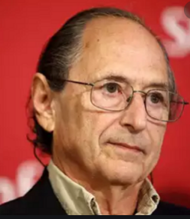
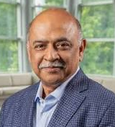
Why CSE initiative @ CU?
2018 WCCM in NYC
Plenary speakers
Congress Statistics
Participants 3200
Countries: 52
Minisymposia: 300
Michael Levitt
Nobel Laureate
Chemistry 2013
Arvind Krishna
Chairman & CEO
IBM
By far the largest participation of faculty and students from Columbia University!
Notes:
Well, CSE is not entirely a new discipline, so why over suddenly this initiative at CU? I must acknowledge that for me personally the main trigger was the largest gathering of top computational scientists and engineers during the 2018 World Congress, which was attended by over 3200 participants from 52 countries and featured computational science heavyweights from industry and academia, such as Michael Levitt….. and Arvind Krishna just to name a few. What was surprising is that by far the largest participation of faculty was not from the usual suspects, such as MIT, Stanford, UT Austin, but from Columbia University.

Slide 5
iCSE (SEAS) faculty
APAM (12)
Qiang Du
Simon Billinge
Kyle Mandli
Chris Marianetti
Kui Ren
Donsub Rim
Marc Spiegelman
Michael Tippett
Michael Weinstein
Lorenzo Polvani
Adam Sobel
Renata Wentzcovitch
BME (5)
Tal Danino
Andreas H. Hielscher
Andrew Laine
Barclay Morrison III
Paul Sajda
ME (7)
Gerard A. Ateshian
Michael P. Burke
Matei Ciocarlie
Jeffrey Kysar
Hod Lipson
Kristin Myers
Vijay Vedula
CHEM (4)
Chris Boyce
Sanat Kumar
Venkat Venkatasubramanian
Alan West
IEOR (8)
Ton Dieker
Yuri Faenza
Ali Hirsa
Henry Lam
Karl Sigman
Van-Anh Truong
Daniel Bienstock
Clifford Stein
CEEM (9)
Jacob Fish
Marco Giometto
Ioannis Kougioumtzoglou
Waiching Sun
Haim Waisman
Huiming Yin
George Deodatis
Raimondo Betti
Addis Kidane
EE (5)
Dimitris Anastassiou
Aurel Lazar
Zoran Kostic
Mingoo Seok
Predrag Jelenkovic
EEE(5)
Xi Chen
Pierre Gentine
Ryan Abernathey
Upmanu Lall
Bolun Xu
CS (2)
Steven Feiner
Changxi Zheng
Notes:
Indeed, we have a critical mass here to undertake any CSE related research. Just in SEAS alone we have 60 faculty from all 9 SEAS departments involved in various CSE areas, and this does not include those with primary focus in AI and Data Science. This also does not include faculty from schools of Business, Medicine, Arts and Sciences, and the new school of Climate where CSE is so critical.

Slide 6
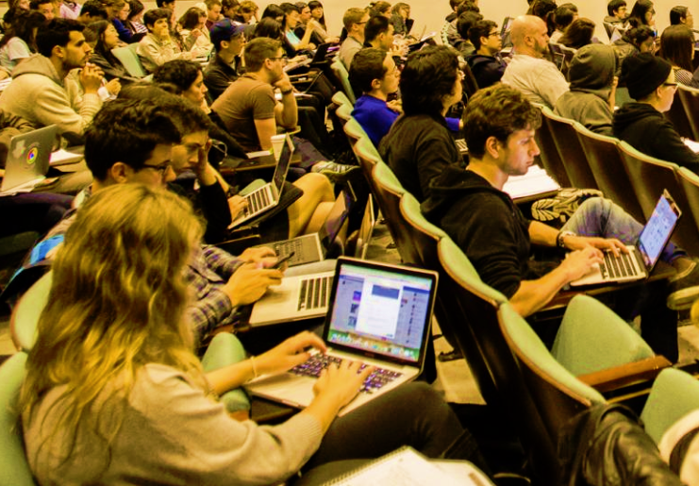
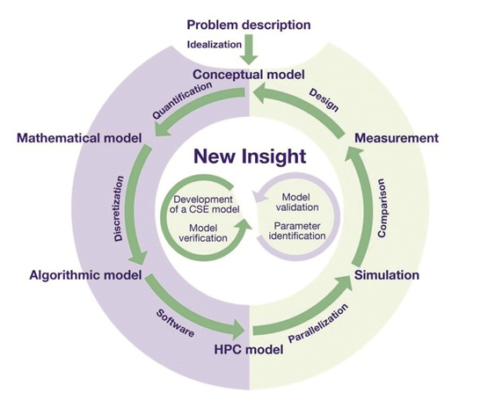
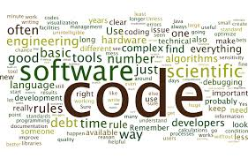
What are the iCSE building blocks?
CEEM offers MS specialization in:
Computational and Data-Driven Engineering Mechanics
iCSE Collaborative Research
iCSE Graduate Program*
Applied Science and Engineering Disciplines
Computer Science
Mathematics & Statistics
*Initially to be administered by
individual SEAS departments
iCSE
iCSE Members and Affiliates Program (MAP)
iCSE
Health
Security
Sustainability
Creative
Materials
Climate
Engineering for humanity
iCSE Membership
iCSE
iCSE
iCSE Seminars
Notes:
First, we offer collaborative research environment where faculty from diverse areas of CSE can work together and tackle critical mostly interdisciplinary challenges we are facing today. Second, we offer an iCSE Members and Affiliates Program (MAP) with a goal of two-way sharing of information and resources for mutual development. I will discuss it more in detail. In the future we also plan to have an iCSE graduate program, which initially will be administered by individual departments. For instance, the department of Civil Engineering and Engineering Mechanics, is already offering MS specialization in Computational and Data-Driven Engineering Mechanics.

Slide 7
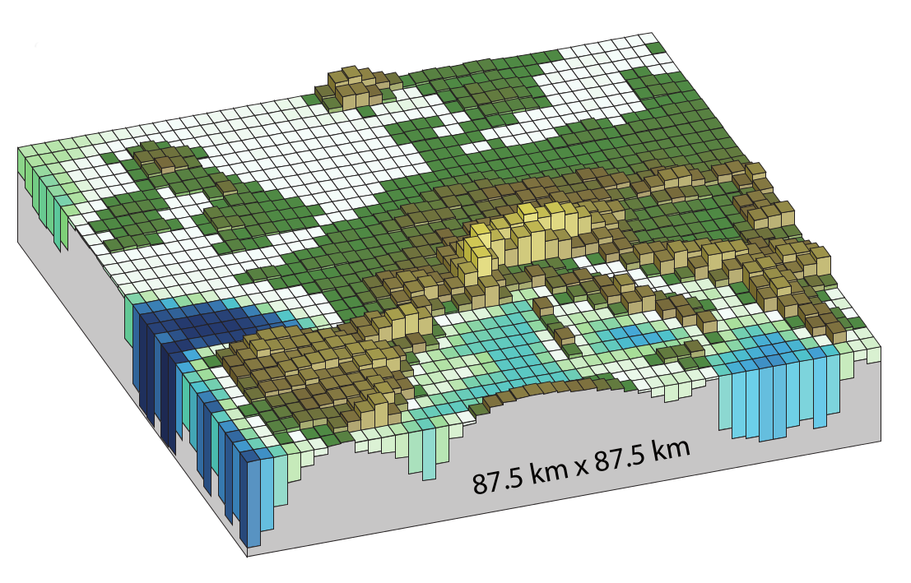
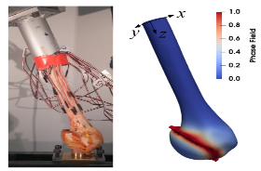
iCSE Collaborative Research areas
Hybrid Physics-Data Driven Computational Science and Engineering
Computational Mathematics and Numerical Analysis
Parallel Computation and Petascale/Exascale Computing
Uncertainty Quantification and Stochastic Modeling
Reduced Order Modeling
Inference, Verification and Validation of Models
Multiphysics and Multiscale Modeling
Computational Climate
Computational Biomechanics and Biology
Computational Neuroscience
Computational Imaging
Computational Health
Computational Mechanics and Materials
Computational Chemistry
Graphics, Animation and Visualization
Optimization
Computational Design, Decision-Making, and Finance
Notes:
The following 17 research areas have identified by iCSE faculty. I am going to read it.

Slide 8
iCSE Members and Affiliates Program (MAP)
 | Charter Member $250K/year | Member $125K/year | Affiliate $25K/year
Member-guided, iCSE faculty-directed research projects(s). | 2 | 1
Visiting iCSE member.
Membership on Advisory iCSE Board.
iCSE faculty visit/seminar on-site at member’s location.
Access to an iCSE faculty open-source software for internal use and a fee-based opportunity to commercialize technology.
Access to iCSE research reports which have not been yet published in the open literature.
Access to “Find an iCSE expert” service.
Recruiting students for summer jobs, internships and full-time positions.
Attend an iCSE Annual meetings.
Recognition on iCSE’s website and promotional materials.
Invitation to other CU SEAS events/symposium, and member-only events.
Notes:
I will now outline the iCSE members and affiliates program (MAP). We offer three levels of membership: Affiliate level @$25k/year, Member level @$125k/year, and Charter Member @$250k/year. Let me start with describing the benefits at the Affiliate level. Access to iCSE research reports…. Find an expert iCSE service. It will work like that. If you are at least at an affiliate level, you can email an iCSE contact person a request for a research in a specific area including available budget. iCSE committee will identify a faculty that has credentials and is willing to conduct research in this area and will connect you with that faculty. Some other benefits include….

Slide 9
Major current research areas Jacob Fish
Computational magnetohydrodynamics solver based on superconvergent hybridizable discontinuous Galerkin method
Early warning system for earthquakes detection
Magnetohydrodynamic sensors
High precision method for drug delivery (example-cancer)
Controlling blood flow and tissue temperature
Multiscale coupled thermo-chemo-mechanical composites manufacturing solver
Predicting process-induced distortions, residual stresses and strength
Compatible with multiscale composite product design solvers
Calibration-free reduced order multiscale solver
Transformational model reduction scheme
Long term research effort
Notes:
Perhaps the most ambitious research effort is on developing calibration-free reduced order multiscale method. Multiscale methods are gaining broader acceptance, but one the major hurdles today is due the fact that they require costly calibration process. Necessity for calibration stems from the fact that various approximations are introduced to cope with disparity of scales. So, for instance if material microstructure consists polymers and/or metals, one must use so-called their effective properties resulting from calibration process, which have little in common with their true physical properties. Nevertheless, existing multiscale approaches work remarkably well for applications that do not require high accuracy. So, just imagine what if one can develop a reduced order multiscale approach that would be calibration-free, and a designer could use material properties and models directly from the manufacturer’s database? This sounds like a dream, but I believe it is feasible.
Thank you. This presentation will be available for download from the iCSE website. We will now turn to the faculty presentations, 15 minutes each. Questions by the end of all presentations.

